Slide 1
Hackathon Scenarios
3 scenarios showing the scope of Azure data and IoT services

Slide 2

Scenario 1: Tracking patients for healthcare
Notes:
Use $5 pi with GPS tracker sensor to monitor the position of an old age patient in a care home – position will be recalculated relatively
GPS will tell us whether patient is within one meter of a location, send sensor telemetry to Azure IoT Suite
Send one message per second to an Azure service, show position changes on PowerBI
Have a second device which will send a backchannel request to put a light on to the nurse or attendant to let them know that they’re outside the vicinity
Hardware needed:
2x pi
Crossover cable to laptop
Learning outcomes:
Pi device programming
Azure IoT Suite
PowerBI
Azure Webjob or other service
IoT backchannel programming (command and control)

Slide 3
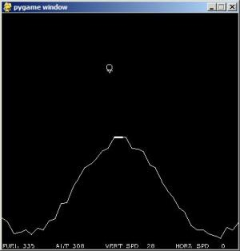

Scenario 2: Monitor game telemetry
Notes:
- Build a game on the pi using Pygame
- Modify the game to generate telemetry on every action
Build in a two course lambda architecture to allow the;
Use of Azure Stream Analytics and PowerBI to give some real-time graphs of the gameplay
ADL and Azure Data Factory to process messages every 15 minutes to understand a longer term trend
Predicting trends with ADF and AzureML
Learning outcomes:
AzureML (supervised learning)
ADF
ADL Storage and Analytics
Azure Stream Analytics
PowerBI
Hardware needed:
pi
Crossover cable to laptop

Slide 4
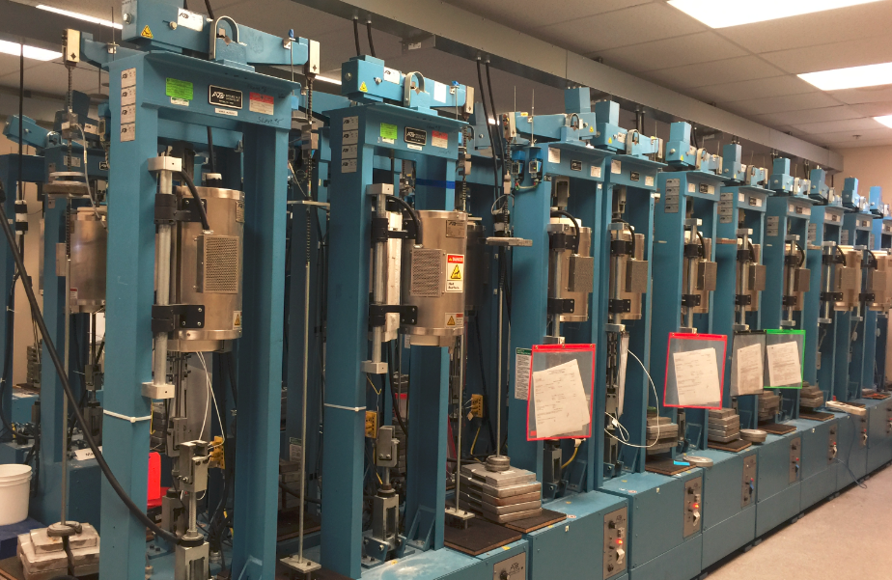

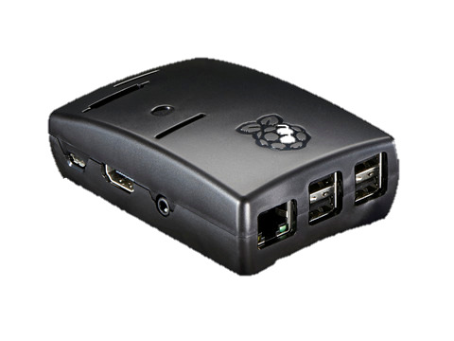
Scenario 3: Monitor machine health with the Pi
Notes:
- Use pi zero with temperature and humidity sensors – check that it generates messages repeatedly every 2 seconds
- Send data to the IoT Suite secured with IoT Suite keys
Process data in real-time with Azure Stream Analytics
Use ASA as passthru to Azure ML predictive maintenance service to flag maintenance issue in real-time
Demonstrate graph using PowerBI of temperature fluctuations over time
As part of the pi software pi will auto-increment each time it sends a metric (incremented value of operational state)
Simulate an IoT Suite backchannel through a service in Azure calling into the registered device to reset the counter
Build in several test scenarios to set off the predictive maintenance function alert
Supply training data as part of this exercise
Hardware needed:
Pi zero
Crossover cable to laptop
Temp and humidity sensors
Outcomes – students will build the following:
Device programming in Python/C# on the pi
Build IoT Suite sink
Build webjob to poll device through backchannel
Build predictive maintenance service in AzureML
Build Azure Stream Analytics service

